Slide 1
HubSpot-Resend Intelligent Email Workflow

Slide 2
Contents
Objective
Workflow Diagram
Working Prototype
Key Performance Observations
Tools Used & Rationale
Limitations & Safeguards

Slide 3
OBJECTIVE
Stores contacts in HubSpot CRM
Generates personalized email content using profile context
Sends emails via Resend API
Tracks replies inside CRM or inbox thread
Demonstrates basic observability of outreach

Slide 4
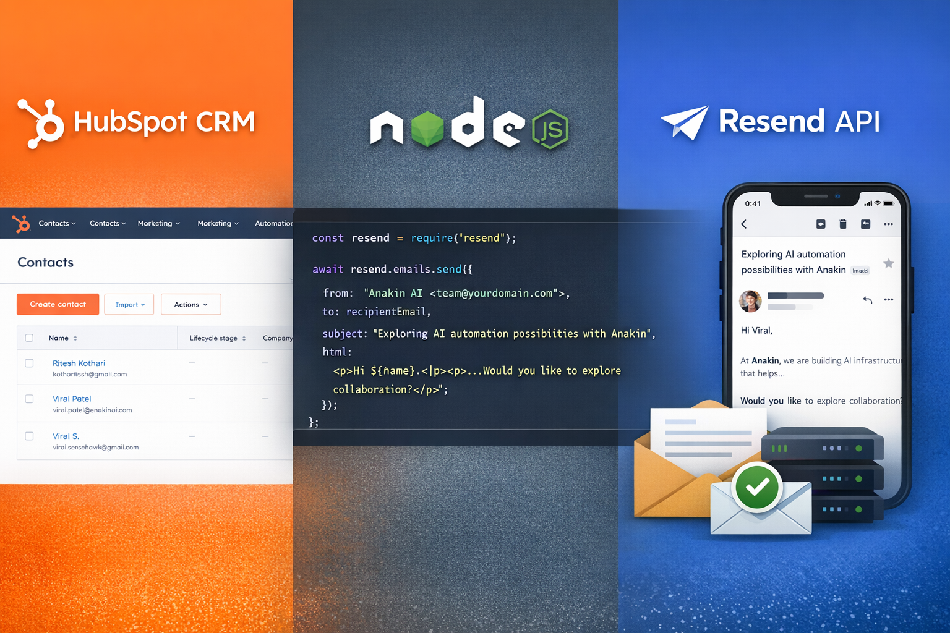
WORKFLOW DIAGRAM

Slide 5
WORKING PROTOTYPE
Component | Description
CRM Setup | Created HubSpot trial account and added 3 contacts
Data Input | Contact emails stored in CRM database
Personalization Logic | Simple AI-assisted business introduction email drafted
Email Sending | Used Resend API to send outreach emails
Delivery Verification | Emails successfully reached inbox
Reply Tracking | Replies appear in Gmail / CRM thread conversation
Tech Stack | HubSpot CRM + Node.js + Resend API
Demo Scope | Shows end-to-end outreach automation pipeline

Slide 6
KEY PERFORMANCE OBSERVATIONS
Metric | Observation
Delivery Rate | Depends on sender domain reputation
Open Rate | Improved by personalization
Reply Rate | Higher with LinkedIn context
Latency | Resend API usually < 1s send time
CRM Sync | Depends on mailbox integration

Slide 7




TOOLS USED AND RATIONALE
Tool | Purpose
HubSpot CRM | Contact management
Resend API | Reliable transactional email sending
Node.js | Lightweight backend prototype
Gmail / Workspace | Reply tracking
Manual LinkedIn Research | Context personalization

Slide 8
LIMITATIONS AND RISKS
Category | Limitations | Safeguards
Data Quality | LinkedIn / contact data may be incomplete or outdated | Verify contact details before outreach
AI Hallucination Risk | Email personalization may generate incorrect business assumptions | Use only validated profile or company data
Deliverability Risk | Emails may go to spam or be blocked | Use verified domain, warm-up sender reputation
Compliance Risk | Possible GDPR / CAN-SPAM violations | Add unsubscribe option and respect consent
Rate Limiting | API or mailbox sending limits | Implement throttling and retry logic

